Slide 1
Santa Clarita Valley Water Agency
Period Ending June 30, 2023
Notes:
LiveForm will have two variables. One for month end, one for previous month end. Add defaults for most recent month end and 3 months prior but the end user can change it.
Address needs to be dynamic based on location of client.
External content for 20% of clients.
What accounts pulled for acct profile section? And what pulled for consolidated?
Reorder functionality for sections.
One account or consolidated?
Account profile has full amount of accounts.
Client Name/household ID can be provided.
On off filter for accts that have been open/closed
Client Name Code column will filter list of accounts
Default everything on.
Give option of Standard or Consolidated.
Default to Standard.

Slide 2
Table of Contents
As of June 30, 2023
SECTION 1 | Economic Update
SECTION 2 | Account Profile
Notes:
Make dynamic TOC

Slide 3
Economic Update
Notes:
Default all on in this section.

Slide 4
Economic Update

Slide 5
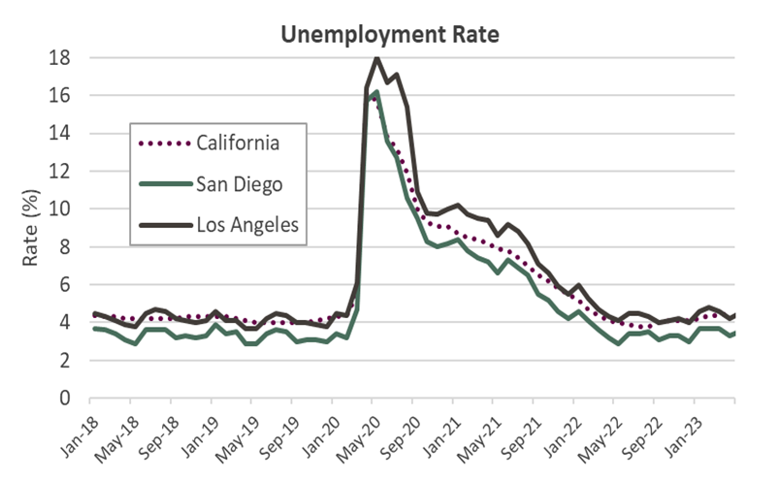
Employment
Source: US Department of Labor
Source: US Department of Labor, Bureau of Labor Statistics

Slide 6
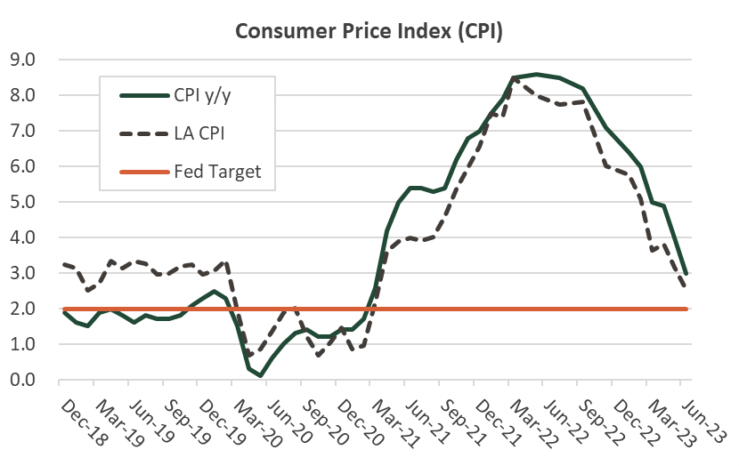
Inflation
Source: Bureau of Labor Statistics and Bureau of Economic Analysis
Source: US Department of Commerce

Slide 7
Account Profile
Notes:
Need option to select accounts to show in account profile.

Slide 8
Compliance
As of June 30, 2023
Notes:
This is currently in excel and manual process each account has its own tab.
Compliance

Slide 9
Compliance
As of June 30, 2023
Notes:
This is currently in excel and manual process each account has its own tab.
Compliance

Slide 10
Portfolio Characteristics
As of June 30, 2023
Santa Clarita Valley Consolidated
 | 06/30/23 | 03/31/23
 | Portfolio | Portfolio
Average Maturity (yrs) | 2.08 | 1.87
Modified Duration | 1.78 | 1.62
Average Purchase Yield | 3.64% | 2.65%
Average Market Yield | 4.62% | 3.43%
Average Quality* | AA/Aa1 | AA+/Aa1
Total Market Value | 280,086,795 | 270,396,622
* Portfolio is S&P and Moody’s respectively.

Slide 11
Sector Distribution
As of June 30, 2023
Santa Clarita Valley Consolidated
June 30, 2023
March 31, 2023

Slide 12
Duration Distribution
As of June 30, 2023
Santa Clarita Valley Consolidated
June 30, 2023 vs. March 31, 2023
 | 0 - 0.25 | 0.25 - 0.50 | 0.50 - 1 | 1 - 2 | 2 - 3 | 3 - 4 | 4 - 5 | 5+
06/30/23 | 36.3% | 4.2% | 11.6% | 14.0% | 12.0% | 4.3% | 3.5% | 14.1%
03/31/23 | 42.6% | 3.2% | 12.5% | 13.0% | 9.8% | 0.5% | 5.6% | 12.9%
Notes:
QuarterlyPackage_DurationDistributionVsTime
Get Total Value of Date To and Total Value of Date From
Divide each value by total value to get Percentage.

Slide 13
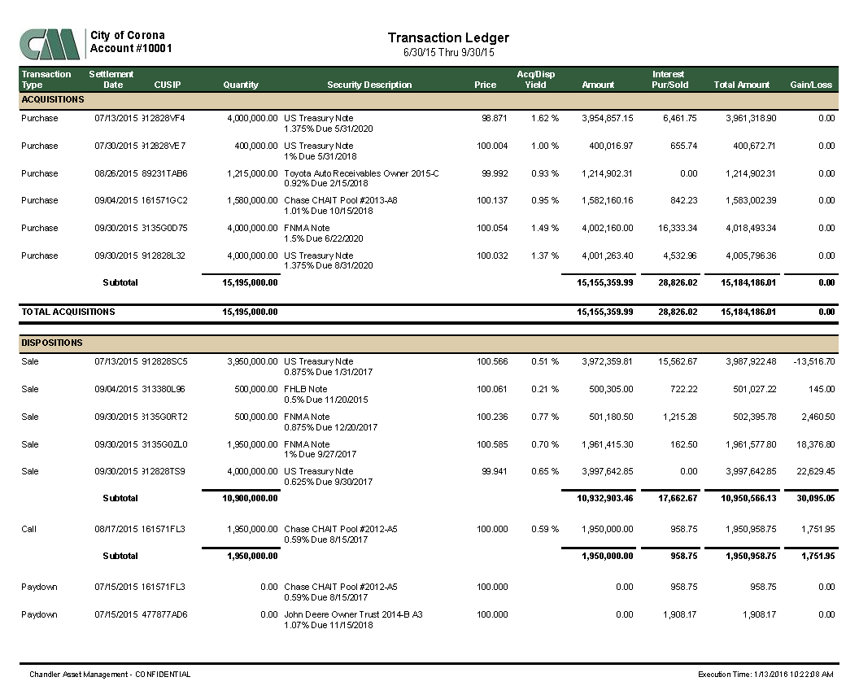
Important Disclosures
As of June 30, 2023
2023 Chandler Asset Management, Inc, An Independent Registered Investment Adviser.
Information contained herein is confidential. Prices are provided by ICE Data Services Inc (“IDS”), an independent pricing source. In the event IDS does not provide a price or if the price provided is not reflective of fair market value, Chandler will obtain pricing from an alternative approved third party pricing source in accordance with our written valuation policy and procedures. Our valuation procedures are also disclosed in Item 5 of our Form ADV Part 2A.
Performance results are presented gross-of-advisory fees and represent the client’s Total Return. The deduction of advisory fees lowers performance results. These results include the reinvestment of dividends and other earnings. Past performance may not be indicative of future results. Therefore, clients should not assume that future performance of any specific investment or investment strategy will be profitable or equal to past performance levels. All investment strategies have the potential for profit or loss. Economic factors, market conditions or changes in investment strategies, contributions or withdrawals may materially alter the performance and results of your portfolio.
Index returns assume reinvestment of all distributions. Historical performance results for investment indexes generally do not reflect the deduction of transaction and/or custodial charges or the deduction of an investment management fee, the incurrence of which would have the effect of decreasing historical performance results. It is not possible to invest directly in an index.
Source ICE Data Indices, LLC ("ICE"), used with permission. ICE permits use of the ICE indices and related data on an "as is" basis; ICE, its affiliates and their respective third party suppliers disclaim any and all warranties and representations, express and/or implied, including any warranties of merchantability or fitness for a particular purpose or use, including the indices, index data and any data included in, related to, or derived therefrom. Neither ICE data, its affiliates or their respective third party providers guarantee the quality, adequacy, accuracy, timeliness or completeness of the indices or the index data or any component thereof, and the indices and index data and all components thereof are provided on an "as is" basis and licensee's use it at licensee's own risk. ICE data, its affiliates and their respective third party do not sponsor, endorse, or recommend chandler asset management, or any of its products or services.
This report is provided for informational purposes only and should not be construed as a specific investment or legal advice. The information contained herein was obtained from sources believed to be reliable as of the date of publication, but may become outdated or superseded at any time without notice. Any opinions or views expressed are based on current market conditions and are subject to change. This report may contain forecasts and forward-looking statements which are inherently limited and should not be relied upon as indicator of future results. Past performance is not indicative of future results. This report is not intended to constitute an offer, solicitation, recommendation or advice regarding any securities or investment strategy and should not be regarded by recipients as a substitute for the exercise of their own judgment.
Fixed income investments are subject to interest, credit and market risk. Interest rate risk: the value of fixed income investments will decline as interest rates rise. Credit risk: the possibility that the borrower may not be able to repay interest and principal. Low rated bonds generally have to pay higher interest rates to attract investors willing to take on greater risk. Market risk: the bond market in general could decline due to economic conditions, especially during periods of rising interest rates.
Ratings information have been provided by Moody’s, S&P and Fitch through data feeds we believe to be reliable as of the date of this statement, however we cannot guarantee its accuracy.
Security level ratings for U.S. Agency issued mortgage-backed securities (“MBS”) reflect the issuer rating because the securities themselves are not rated. The issuing U.S. Agency guarantees the full and timely payment of both principal and interest and carries a AA+/Aaa/AAA by S&P, Moody’s and Fitch respectively.
Your qualified custodian bank maintains control of all assets reflected in this statement and we urge you to compare this statement to the one you receive from your qualified custodian. Chandler does not have any authority to withdraw or deposit funds from/to the custodian account.
Notes:
TransactionLedgerQuarterly
Dynamic amount of pages based off data
Sec Desc =
Acq/Disp Yield = If differs from 0 divide by 100, else leave blank
Total Amount = Principal + Interest + Trade Fee
Gain/Loss = Gain + Loss
If(altdate = “#1/1/1900#”,””,
If(altrate value > 0, enter to next line
If true = then enter to next line and include AltRate with Pct Sign, else “”
ALWAYS Concatenate Due: AltDate
Due 1/1/1900 – do not show due date if it equals 1/1/1900

Slide 14
Benchmark Disclosures
As of June 30, 2023
ICE BofA 1-10 Yr US Treasury & Agency Index The ICE BofA 1-10 Year US Treasury & Agency Index tracks the performance of US dollar denominated US Treasury and nonsubordinated US agency debt issued in the US domestic market. Qualifying securities must have an investment grade rating (based on an average of Moody’s, S&P and Fitch). Qualifying securities must have at least one year remaining term to final maturity and less than ten years remaining term to final maturity, at least 18 months to maturity at time of issuance, a fixed coupon schedule, and a minimum amount outstanding of $1 billion for sovereigns and $250 million for agencies.
ICE BofA 0-3 Yr US Treasury & Agency Index ICE BofA 0-3 Year US Treasury & Agency Index tracks the performance of US dollar denominated US Treasury and nonsubordinated US agency debt issued in the US domestic market. Qualifying securities must have an investment grade rating (based on an average of Moody’s, S&P and Fitch). In addition, qualifying securities must have a remaining term to final maturity less than 3 years, at least 18 months to maturity at time of issuance, a fixed coupon schedule and a minimum amount outstanding of $1 billion for sovereigns and $250 million for agencies. "Global" securities (debt issued simultaneously in the eurobond and US domestic markets) and 144a securities qualify for inclusion in the Index. Subordinated US agency securities are excluded from the index. Callable perpetual securities qualify provided they are at least one year from the first call date. Fixed-to-floating rate securities also qualify provided they are callable within the fixed rate period and are at least one year from the last call prior to the date the bond transitions from a fixed to a floating rate security. Bills, inflation-linked debt and strips are also excluded from the Index; however, original issue zero coupon bonds are included in the Index and the amounts outstanding of qualifying coupon securities are not reduced by any portions that have been stripped.
Notes:
TransactionLedgerQuarterly
Dynamic amount of pages based off data
Sec Desc =
Acq/Disp Yield = If differs from 0 divide by 100, else leave blank
Total Amount = Principal + Interest + Trade Fee
Gain/Loss = Gain + Loss
If(altdate = “#1/1/1900#”,””,
If(altrate value > 0, enter to next line
If true = then enter to next line and include AltRate with Pct Sign, else “”
ALWAYS Concatenate Due: AltDate
Due 1/1/1900 – do not show due date if it equals 1/1/1900

